Slide 1
TE Mini Project 2B-ML Based Face Recognition Based Attendance System
Ayush Yelne (IT2 Roll No. 63)
Vikas Yadav (IT2 Roll No. 62
Naima Dalwai (IT2 Roll No. 75)
Pranav Satam(IT2 Roll No. 38)
Date of presentation: -
Under the guidance of: Prof. Anuradha Kapoor
Atharva College of Engineering
Department of Information Technology
2021-2022

Slide 2
Content
● Introduction
● Aim/Objectives
● Literature Survey work
● Problem statement
● Proposed Solution
● Block Diagram of solution
● Scope and Feasibility
● Hardware and Software requirements
● Data Preparation, Feature Engineering
● Methodology (ML Algorithm description)
● Implementation (Training the Model)
● Result Analysis (Evaluating the Model)
● Discussion (Parameter tuning and Inference)
● Model deployment
● Conclusion

Slide 3
Introduction
Over the past decade, taking down students’ attendance process had been developed and changed.
The driven force of this development is the desire to automate, facilitate, speed up and save time and efforts.
In this project, we attempt to reduce wasted time, eliminate buddy clocking, and automate the process.
Our system uses facial recognition technology to record the attendance through a high resolution digital camera that detects and recognizes faces and compare the recognize faces with students’ faces images stored in faces database.
Once the recognized face matches a stored image, attendance is marked in attendance database for that person.

Slide 4
Literature survey work
TITLE | YEAR | AUTHOR | PUBLISHER | REFERENCE LINK | OBSERVATION
Face Recognition based Attendance Management System | 2020 | Smitha, Pavithra S Hegde, Afshin | IJERT | https://www.researchgate.net/publication/341876647_Face_Recognition_based_Attendance_Management_System | To get the best facial recognition algorithm provided by the opencv by comparing the receive operating system characteristic.
Face Recognition Based Attendance System | 2019 | Nandhini R, Duraimurugan N, S.P.Chokkalingam | IJEAT | https://www.ijeat.org/wp-content/uploads/papers/v8i3S/C11230283S19.pdf | The paper proposed that the system takes the attendance automatically recognition obtained by continuous observation that helps to improve the performance..
Face Recognition based Attendance System | 2020 | Dhanush Gowda H.L, K Vishal, Keertiraj B. R, Neha Kumari Dubey, Pooja M. R. | IJERT | https://www.irjet.net/archives/V8/i4/IRJET-V8I4278.pdf | In this paper, method for student attendance system using open cv and support vector machine(SVM) algorithm is used to implement the system.

Slide 5
Problem Statement
The concept of face recognition is to give a computer system the ability of finding and
recognizing human faces fast and precisely in images or videos.
Numerous algorithms and techniques have been developed for improving the performance of face recognition.
Facial features are extracted and implemented through algorithms, which are
efficient and some modifications are done to improve the existing algorithm models.
The face recognition system generally involves two stages:
• Face Detection – where the input image is searched to find any face, then image
processing cleans up the facial image for easier recognition.
• Face Recognition – where the detected and processed face is compared to the database of
known faces to decide who that person is.

Slide 6
Proposed Solution
The task of the proposed system is to capture the face of each student and to store it in the database for their attendance.
The face of the student needs to be captured in such a manner that all the feature of the students' face needs to be detected, even the seating and the posture of the student need to be recognized.
There is no need for the teacher to manually take attendance in the class because the system records a video and through further processing steps the face is being recognized an
ACE- IT department Face recognition based attendance system

Slide 7
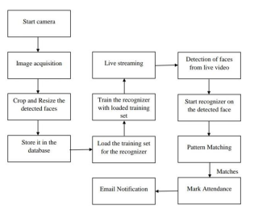
BLOCK DIAGRAM OF SOLUTION
ACE- IT department Face recognition based attendance system

Slide 8
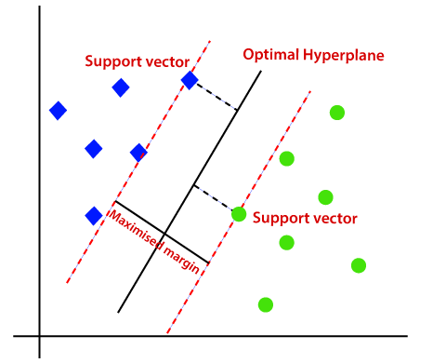
Algorithm
SVM
Support Vector Machine(SVM) is a supervised machine learning algorithm used for both classification and regression.
ACE- IT department Face recognition based attendance system

Slide 9
Scope and Feasibility
Our project targets the students of different academic levels and faculty members. The main constraint we faced is distinguishing between identical twins. This situation is still a challenge to biometric systems especially facial recognition technology.

Slide 10
Hardware and Software requirements
Python 3.6
OpenCv
Pandas
TKinter

Slide 11
Data Preparation, Feature Engineering

Slide 12
Methodology
SVM: Support Vector Machine(SVM) is a supervised machine learning algorithm used for both classification and regression.

Slide 13
Face recognition has developed into a major research area in pattern recognition and computer vision.
Face recognition is different from classical pattern-recognition problems such as character recognition.
In classical pattern recognition. there are relatively few classes, and many samples per class. With many samples per class. algorithms can classify samples not previously seen by interpolating among the training samples.
On the other hand, in 804 P. J Phillips face recognition, there are many individuals (classes), and only a few images (samples) per person, and algorithms must recognize faces by extrapolating from the training samples.
In numerous applications there can be only one training sample (image) of each person.

Slide 14
Implementation
Detecting faces: The detector can be synchronized by a frame to detect faces. The result returned includes a collection of Face instances according to the dimensions of each face (x1, y1, x2, y2)
Facial Features Extraction: This is the process of extracting facial landmarks. A landmark is a point of interest within a face such as the left eye, right eye, and nose base. Figure below shows some examples of facial landmarks:

Slide 15
It detects all landmarks with the position of (cx, cy). The detected landmarks are shown in the Figure below:

Slide 16
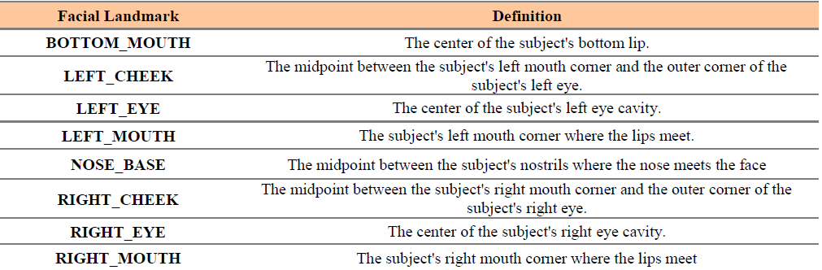
The pixel of the center of the right eye is taken as (x1,y1), the pixel of the center of the left eye is taken as (x2,y2), the pixel of the center of the left cheek is taken as (x3,y3), the pixel of the center of the right cheek is taken as (x4,y4), the pixel of the bottom mouth is taken as (x5,y5), the pixel of left mouth is taken as (x6,y6), the pixel of the right mouth is taken as (x7,y7) and the pixel of the center of the nose is taken as (x8,y8). We calculate the distances to obtainthe 30 measurements.
These measurements are in Table below

Slide 17
Geometrical feature measurements: These measurements are computed based on the facial parts’ locations as follows: Assume the pixel of the center of the right eye is taken as (x1,y1), the pixel of the center of the left eye is taken as (x2,y2), the pixel of the center of the left cheek is taken as (x3,y3), the pixel of the center of the right cheek is taken as (x4,y4), the pixel of thebottom mouth is taken as (x5,y5), the pixel of left mouth is taken as (x6,y6), the pixel of the right mouth is taken as (x7,y7) and the pixel of the center of the nose is taken as (x8,y8). The normalized distance between these points is calculated by distance calculation algorithm in the formula: Distance =Sqrt ((xi-xj) ^2) +((yi-yj) ^2)
Applying the previous formula (for i, j = 1,2,3,…,8), there are 30 distances obtained as:
1. Distance between left eye and right eye (d1)
2. Distance between right eye and right cheek (d2)
3. Distance between right eye and nose base (d3)
4. Distance between left eye and left cheek (d4)
5. Distance between left eye and nose base (d5)
6. Distance between right cheek and nose base (d6)
7. Distance between left cheek and nose base (d7)

Slide 18
8. Distance between right cheek and right mouth (d8)
9. Distance between right cheek and bottom mouth (d9)
10. Distance between nose base and right mouth (d10)
11. Distance between nose base and bottom mouth (d11)
12. Distance between nose base and left mouth (d12)
13. Distance between right mouth and bottom mouth (d13)
14. Distance between bottom mouth and left mouth (d14)
15. Distance between right mouth and left mouth (d15)
16. Distance between left cheek and left mouth (d16)
17. Distance between left cheek and bottom mouth (d17)
18. Distance between left cheek and right cheek (d18)
19. Face width (d19)
20. Face height (d20).
21. Distance between right eye and left mouth (d21)

Slide 19
22. Distance between right eye to left cheek (d22)
23. Distance between left eye to right cheek (d23)
24. Distance between left eye to right mouth (d24)
25. Distance between left eye to bottom mouth (d25)
26. Distance between left eye to left mouth (d26)
27. Distance between right eye to right mouth (d27)
28. Distance between right cheek to left mouth (d28)
29. Distance between left cheek to right mouth (d29)
30. Distance between right eye to bottom mouth (d30)

Slide 20
Result Analysis
This systems can differentiate between the authorized and unauthorized users. The main steps of face recognition system are illustrated as follows:
Input Image
Input image is taken by turning on the webcam of the laptop. Webcam is used as an input method for detecting the user’s face.
2. Face Detection
After detecting the face of the user, we take 50 sample photos of the user and store them in the folder.
3. Feature Extraction
Further, the features of the user’s face is extracted like distance between mouth and nose, nose and eyes, etc.

Slide 21
Input Image Face Detection Features Extraction

Slide 22
Discussion

Slide 23
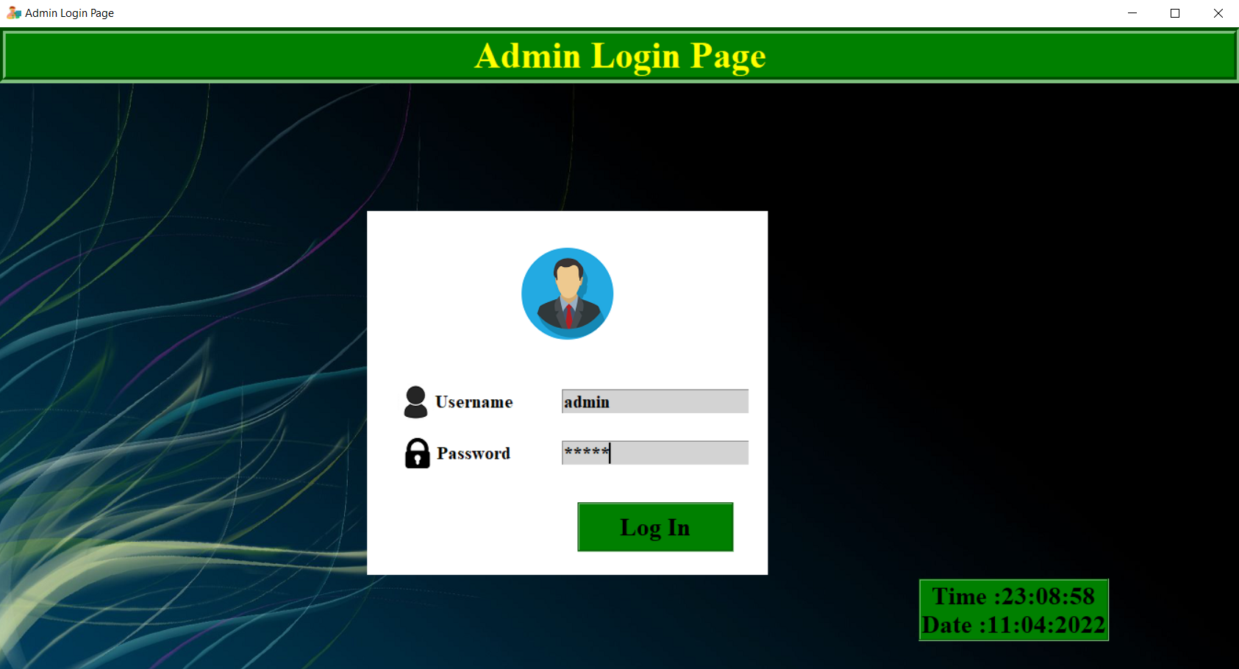
Model Deployment
Login Page

Slide 24
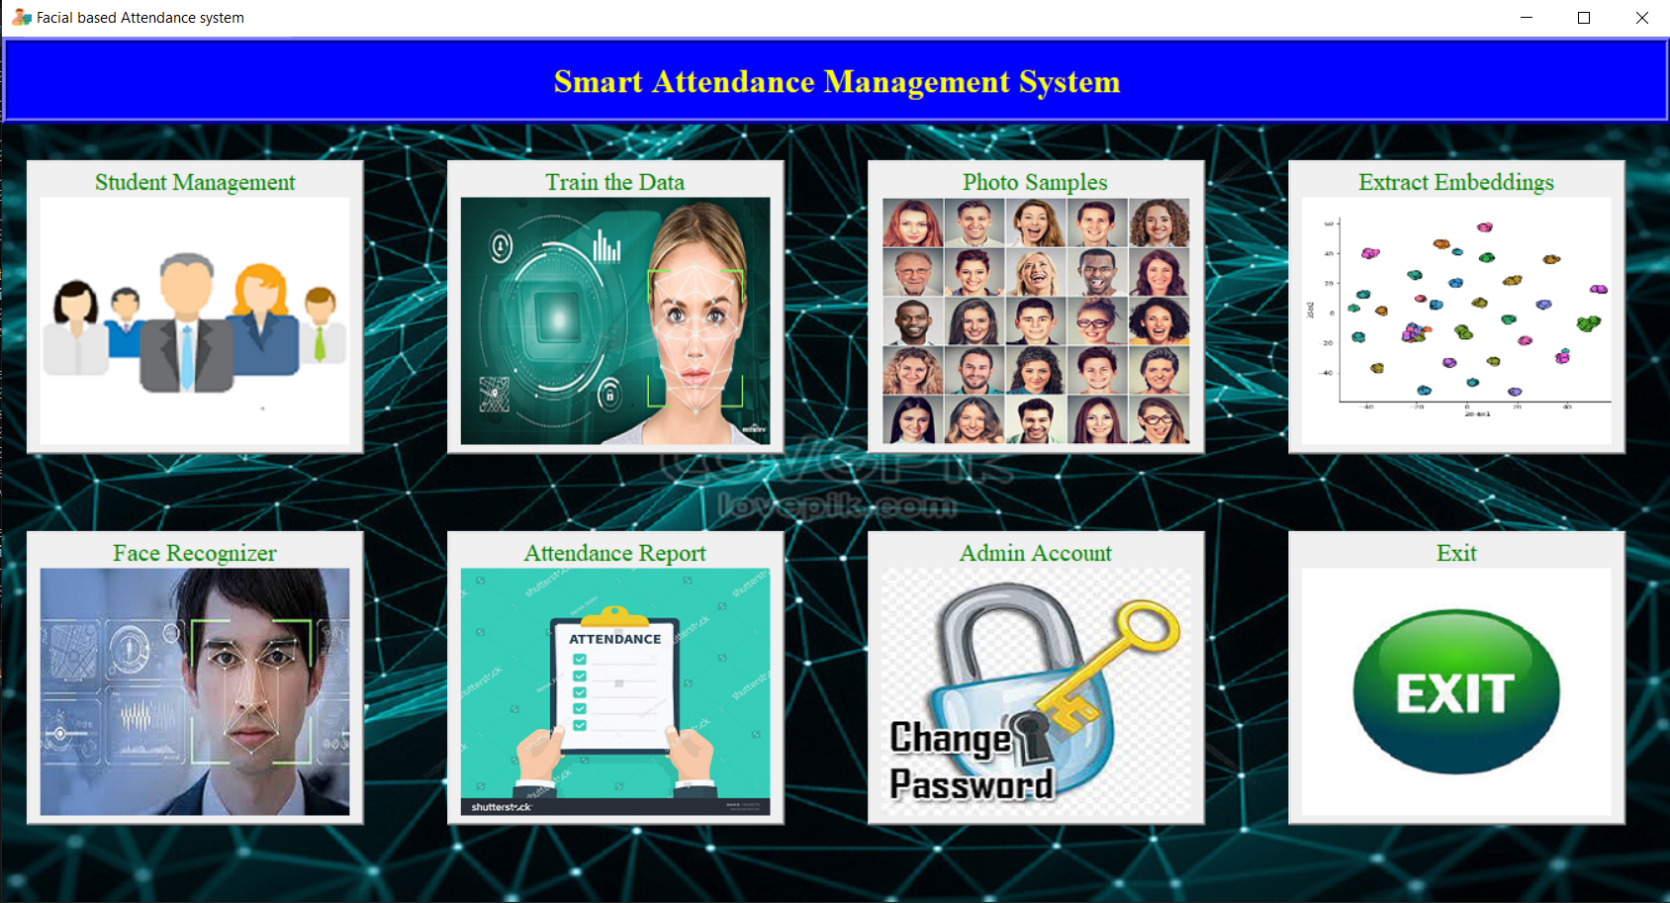
Home Page

Slide 25
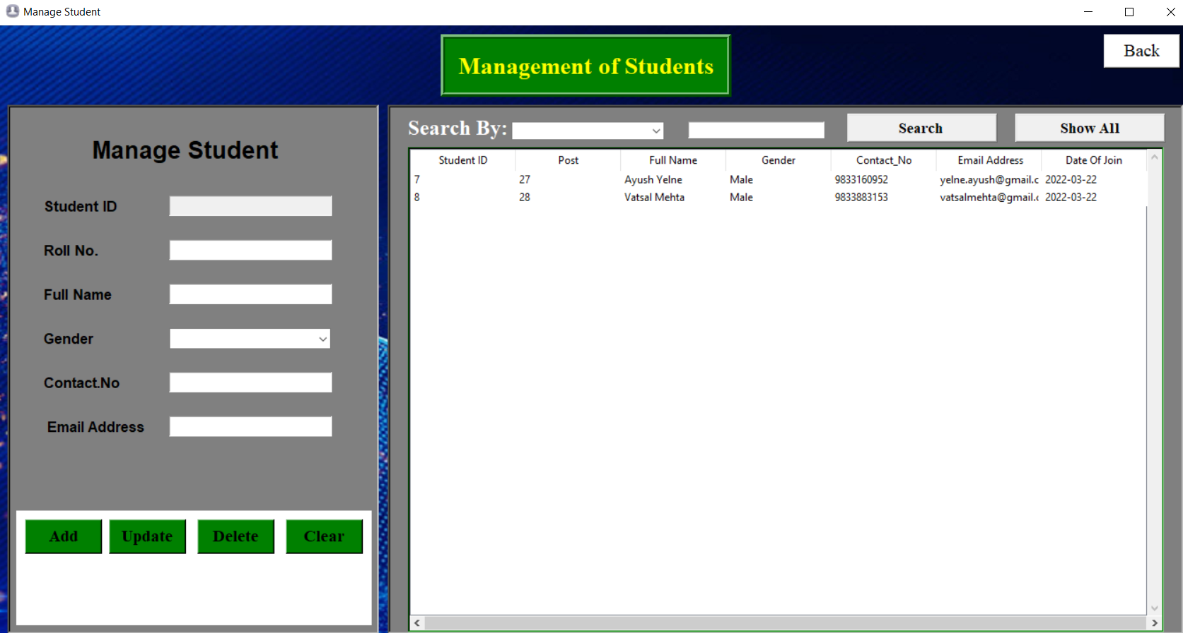
Student Management

Slide 26
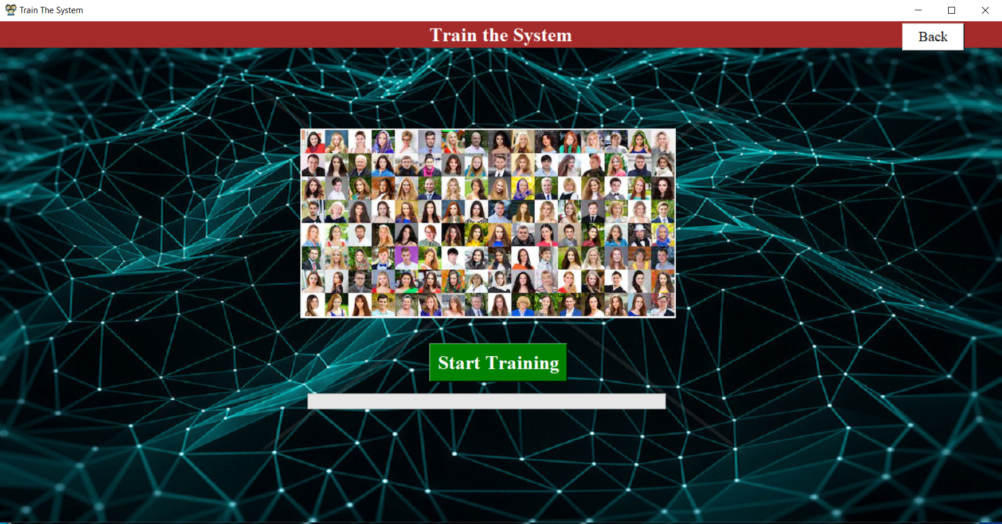
Data Training

Slide 27
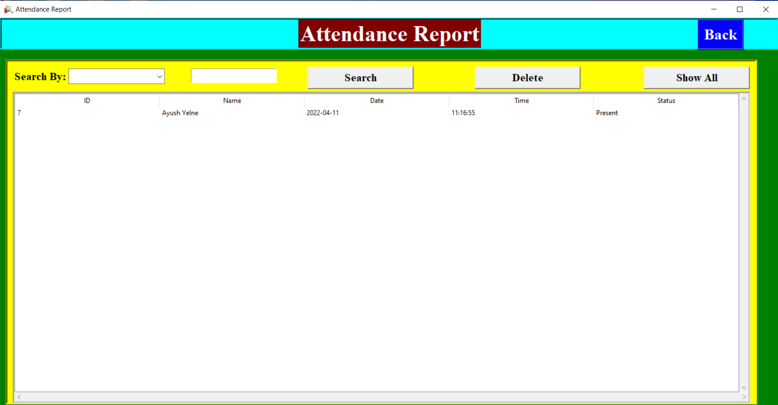
Attendance Report

Slide 28
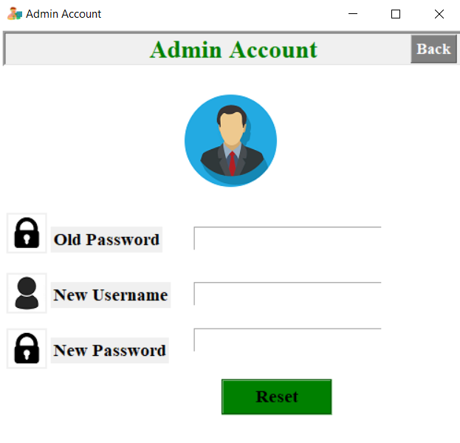
Admin Dashboard

Slide 29
THANK YOU!

